Slide 1


KARNAVATI UNIVERSITY
Unitedworld Institute of Technology
Event Registration Portal
Professional Training
Semester: 4th
Programme: B. Sc. (Hon’s)
Guided by:
Ms. Rama M. Maliya and Mr. Sanjay Ajani
Assistant Professor
UIT, KU
Prepared by:
Aditya Harsh (20220701004)

Slide 2




FRONT END
TECHNOLOGY
HTML
CSS
BACKEND
TECHNOLOGY
My SQL
php
JS

Slide 3

PROJECT
Functionalities
In this project the user enter there name email address and the event the want to register for.There are total 3 different event that the user can join.There data get saved in the database through xamp server.

Slide 4
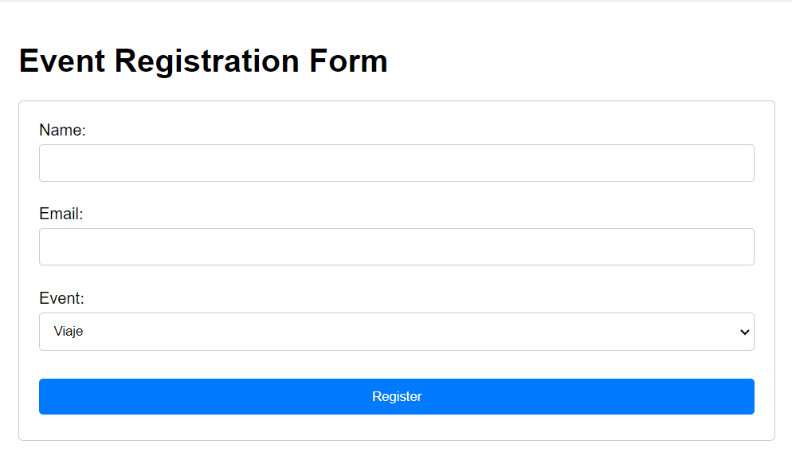
PROJECT
Screenshots

Slide 5
PROJECT LINK
GitHub Link:
https://github.com/Adityaharsh7/PT.git

Slide 6
THANK YOU

